Slide 1



Teaching the Translation of Chinese Phrasemes Chengyu to French-speaking Students
Manon Hayette & Kevin Henry Université de Mons

Slide 2
Context of Chinese translation teaching in French-speaking Belgium
Two universities in French-speaking Belgium:
Brussels since 2005 (ISTI university college, then Université libre de Bruxelles)
Mons in 2015 (Université de Mons)
5-year program: undergraduate (3 years) + graduate (2 years)
No prior knowledge of Chinese required => teaching of Chinese language (phonetics, writing, grammar, vocabulary) from zero. Students continue to learn the language alongside translation techniques up to the final year of the curriculum.
Introduction to Chinese-French translation in the 2nd year, with an additional overview of China’s ancient and contemporary history and culture.

Slide 3
Chengyu 成语 in translation teaching: State of the art
Four-syllable phraseological units chengyu are an integral component of Chinese discourse (Wang & Luo 2021, 284).
While their mastery is essential for attaining fluency (Schmitt 2000; Wood 2016), chengyu have received scant attention in L2 pedagogy (Conti 2020; Guo 2017; Chen 2024) and even less so in translation teaching.
Yet, these ‘untranslatable’ units (Tidjon Djambong 2021, 389) have been identified as an intercultural obstacle for translation learners (Pellatt & Liu 2010, 145).

Slide 4
Chengyu 成语 in translation teaching: State of the art
Indeed, as their meanings frequently involve cultural or historical allusions (Nall 2009, 124–129) and generally are non-compositional, students, who are still developing their linguistic competence, cannot rely on previous experience to properly comprehend and translate such complex items (Robles Sabater 2016, 18).
Furthermore, the concise structure of chengyu (Xu, 2006, 107; Conti, 2019, 12) poses a challenge for students, who may resort to verbose renditions (following definitions in dictionaries).
Some scholars have even recommended avoiding translating chengyu altogether (Pellatt & Liu 2010, 145).

Slide 5
Definition of Chengyu 成语
A problem surrounding chengyu pedagogy is the unresolved ambiguity about their distinctive criteria (Henry 2016; Conti 2019, 2020).
Conti | Henry
Four-character, ‘bipartite’ structure | Quaternary rhythm (in most cases)
Formal stability, morphemic and syntactic invariability | Relatively fixed (syntactic fixity, lexical blocking and possible non-compositionality)
Meaning invariable, non-compositional
Lexematic-type expressions that generally behave like syntagms, although phrasal behaviour is sometimes observed | Integrative structures, being able to occupy any functional position
Belongs to the standard language, and is primarily used in the literary register | Originally of high or formal register, with a prominent citational character
 | Inscribed in the memory heritage of the speakers and frequently with a strong allusive character

Slide 6
Chengyu 成语 within general phraseology
Meľčuk’s universal typology (2011):
Phrasemes = constrained (un-free) phrases
Pragmatic phrasemes / pragmatemes = phrasemes constrained by linguistic situation
Semantic phrasemes
Collocations = phrasemes semantically compositional but syntactically constrained by one component
Clichés = phrasemes semantically compositional but syntactically constrained by all the components
Locutions = phrasemes semantically non-compositional and syntactically constrained
In this typology, chengyu are to be classified within at least Meľčuk’s two last categories, i.e. clichés and locutions.

Slide 7
Chengyu 成语 within general phraseology: Examples
【爱不释手】 ai-bu-shi-shou [love-not-release-hand] = to be very attached to st.
Cliché
Semantically compositional, since it is easy to guess the metaphorical meaning from the meaning of its constituent parts.
Syntactically constrained and non-compositional: its components must be used as a whole for the communication situation to succeed.

Slide 8
Chengyu 成语 within general phraseology: Examples
【画蛇添足】 hua-she-tian-zu [draw-snake-add-leg] = to gild the lily, to overdo
Locution
Impossible to determine the final metaphor conveyed by the phrase from the constituents taken independently (the complex sign ABCD in chengyu is not made up of the signs A, B, C and D).
As a phrase, this locution is syntactically constrained, so that it must be considered as a whole.

Slide 9
Chengyu 成语 within general phraseology
Meľčuk’s (2023) precises the notion of cliché by proposing four sub-categories according to the contraints to which its referent may be subject: nicknames, termemes, formulemes and sentencemes.
However, the definitions given by Meľčuk exclude chengyu altogether from these four sub-categories.
An extension of Meľčuk’s typology should therefore be considered if we wish to include these very specific expressions.

Slide 10
Chengyu 成语 in reference material
Dictionaries, ‘universally recognised as indispensable sources of information on the lexicon and as irreplaceable working tools for many language professions’, including translators, and which allow language ‘to exist’ (Meľčuk, Clas & Polguère, 1995, p.22) are consequently the tools of choice for students when they find themselves faced with these translational challenges.
Another kind of reference material are official standards. However, we can notice inconsistencies between the various Chinese proficiency standards (HSK, GF 0025–2021, TOCFL, TBCL) in selecting and classifying chengyu.
These discrepancies can impede curriculum design, including translation programs.

Slide 11
Chengyu 成语 in Chinese official standards
HSK 汉语水平考试 > Mainland China (2 versions: 1992; 2010-2012)
GF 0025–2021 国际中文教育中文水平等级标准 > Mainland China (2021)
TOCFL > Taiwan
TBCL > Taiwan

Slide 12
Estimated level at the CECR | HSK 2010/2012 Level | HSK 2010/2012 Words | 国际中文教育中文水平等级标准 Chinese Proficiency Grading Standards for International Chinese Language Education GF 0025–2021 |  | GF 0025–2021 Words | TOCFL Level |  | TOCFL Words | TBCL Level |  | TBCL Words
 | 一级 Level 1 | 150 |  |  |  | 準備級 Novice | 準備級一級 Novice 1 | 160
 | 二级 Level 2 | 300 |  |  |  |  | 準備級二級 Novice 2 | 393 | Basic | 準備級 Level 1 | 396
Level A1 | 三级 Level 3 | 600 | 初等 Beginner | 一级 Level 1 | 500 | 入門基礎級 Band 1 | 入門級 Level 1 | 740 |  | 入門級 Level 2 | 798
 | 四级 Level 4 | 1200 |  | 二级 Level 2 | 1272 |  | 基礎級 Level 2 | 1225 |  | 基礎級 Level 3 | 1254
Level A2 | 五级 Level 5 | 2500 |  | 三级 Level 3 | 2245 | 進階高階級 Band 2 | 進階級 Level 3 | 2399 | Advanced | 進階級 Level 4 | 2669
Level B1 | 六级 Level 6 | 5000 | 中等 Intermediate | 四级 Level 4 | 3245 |  | 高階級 Level 4 | 4741 |  | 高階級 Level 5 | 5288
 |  |  |  | 五级 Level 5 | 4316
Level B2 |  |  |  | 六级 Level 6 | 5456 | 流利精通級 Band 3 | 流利級 Level 5 | 7517
Level C1 |  |  | 高等 Advanced | 七级 Level 7 八级 Level 8 九级 Level 9 | 11092 |  |  |  | Proficient | 流利A級 Level 6 | 9432
Level C2 |  |  |  |  |  |  | 精通級 Level 6 | ? |  | 流利B級Level 7 | 14425

Slide 13
Chengyu 成语 in Chinese official standards
HSK 2010-2012 | GF 0025–2021 | TOCFL | TBCL
115 chengyu | 410 chengyu | 22 chengyu | 863 chengyu
Level 5 and 6 | Level 4 to 9 + 2 items in Level 2 | Level 5 to 7 | Level 4 to 7
> A2 level | > B1 level | > B2 level | > A2 level

Slide 14
Pilot study
Provide MA1 students with a text containing several chengyu, instructing them to identify them without reference material and then to translate the text into French using only bilingual dictionaries.
Text data: 1076 characters
Source : 中级汉语阅读与写作教程 (Intermediate Chinese Reading and Writing Course), 2006, p.151.
Level : HSK 5-6, contains 14 chengyu.

Slide 15
Pilot study
小孩是人群中的矮人族，他们直立行走，但更多的时候是趴着。他们热爱土地，热爱自由，以玩为生活的主要内容，一脑子玩的思想。小孩的眼睛长得和大人不同，随时能看见大人看不见的东西，如一些微生物，一些飞行物，各类甲虫，并立即与之厮混在一起，不觉得自己跟这些东西有什么两样。小孩的耳朵也设计得很特别，随时听不见大人的呼喊。小孩是天生的自然主义者，他们以为自己降临到这个世界就是专门来玩的。
小孩有自己的社会组织，分布于各地。一个小孩无论走到哪里，都能用个人方式飞快地找到组织，并积极向组织靠拢。这个组织一向从事逃避成人社会的管束，破坏大人的规矩，把家长的话当做耳边风等一系列抵抗活动，主要表现在每天集体把衣服弄脏。小孩普遍崇尚不修边幅，经常反穿鞋子，衣冠不整，以区别于成人社会的衣冠楚楚，道貌岸然。小孩以为以一身肮脏换取快乐是再值不过的，何况衣服是大人花钱买的，钱本来就是脏的。一群小孩中最脏的那几个往往是组织里的核心人物，负责领导大家四处寻找乱七八糟的地方作为据点。他们活跃于沙坑、泥堡，啸聚于砖垛、石堆，潜伏于草丛、墙脚，在这些地带摸爬滚打。由于他们刚从天堂来到世界不久，我们只好相信小孩惯常出没的地带与天堂里的情形大致相同。

Slide 16
Pilot study
小孩与小孩有福同享，有块饼干大家啃，一粒糖果大家轮着舔。小孩喜欢很神秘地藏在某处，像鸵鸟一样把整个屁股都露在外面，自以为藏得很严实。小孩口袋里的宝贝，在大人看来全是废物，那是一些石块，一些铁片、木棒、皮筋和瓶盖，不知他们留有何用。小孩要把相当一部分精力投注到一些创世纪的活动中。他们用吐唾液和撒尿的方式和泥，捏出许多小泥人。一个新的世界就这样诞生了。
你是大人，小孩敢做的事情你不一定敢做。小孩敢在任何场合号啕大哭，你不敢；小孩敢用脏屁股坐到家中洁净的沙发和床上，或站在玻璃茶几上往下跳，你也不敢；小孩还敢把你公司的重要文件折成纸飞机、小船，用来飞翔和航行，甚至撕成雪花乱撒。这个打死你也不敢。
成人比小孩只不过把表面的不洁净藏到内心。每一个成人都怀念童年，却再也回不到童年了。所谓“返老还童”，所谓“童心未泯”，只不过是成人的追求和希望达到的境界。小孩的天真、纯洁、无私、诚实以及坦率，永远都是成人社会的一面镜子。
每一个小孩都要告别自己的时代，走向成人社会。这是小孩悲剧的开始。说谎，是小孩进入成人世界的第一个标志；吃独食表明小孩在继续长大，为第二个标志；知道了钱的用处并利用它，是第三个标志。这样的小孩已经开始脱离集体的社会组织。有朝一日，昔日的小孩朝你走来，他们身材高挑、风度翩翩、仪态万方、举止得体，你就知道他们已经彻底沦落为成人。

Slide 17
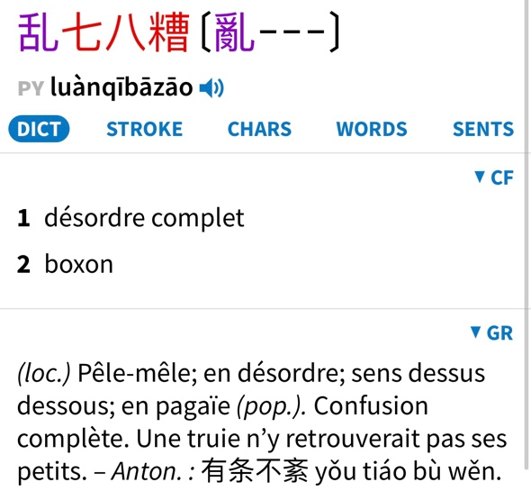
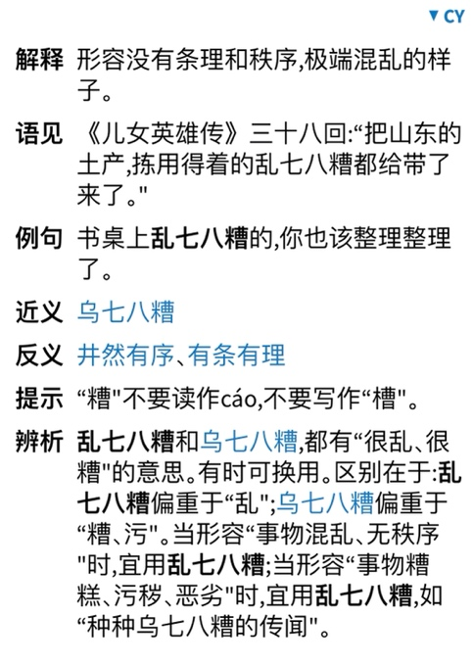
Example of dictionary entry used by the students (Grand Ricci, Pleco & Chengyu Cidian 2009).

Slide 18
A glimpse of the data
Chengyu | Student translation 1 | Student translation 2 | Chengyu | Student translation 1 | Student translation 2
不修边幅 | laisser-aller | le désordre | 有福同享 | partagent leurs bonheurs sans compter | partagent tout entre eux
衣冠不整 | s’habillent n’importe comment | leurs habits de travers | 号啕大哭 | pleurent à grands sanglots | pleurer à chaudes larmes
衣冠楚楚 | bien vêtus | l’élégance | 返老还童 | retomber en enfance | retrouver sa jeunesse
道貌岸然 | sérieux | bien lissée | 童心未泯 | garder une âme d’enfant | garder une âme d’enfant
乱七八糟 | les plus en désordre | pleins de poussière et de mystères | 有朝一日 | puis, un jour | un jour
摸爬滚打 | surmontent diverses épreuves | rampant, grimpant, roulant avec énergie | 风度翩翩 | élégant | élégants
大致相同 | similaires | ressemblent un peu | 仪态万方 | plein d’assurance | pleins de charme, d’assurances
Notes:
Mo-pa-gun-da

Slide 19
Conclusions
Salient points elucidated:
the difficulty in recognizing chengyu (approximately 60% recognized, and 2 erroneous chengyu).
Generally, compositionnal chengyu were more difficult to identify (// Conti, 2020 => the metaphorical value of chengyu positively influences its learning and memorisation >< Petrovčič [2022] and Wang & Luo [2019])
the restrictive nature of bilingual dictionary entries and the shortcomings of monolingual dictionaries : need of more learning dictionaries with appropriate examples (// grammatical functions) and that selects chengyu according to frequency and student levels.
the necessity for including chengyu in translation curricula : but how?

Slide 20
Food for thought
Category | Parameter | Type | Value
Semantical | Opacity | Transparent | 1
 |  | Semi-transparent | 2
 |  | Opaque | 3
 | Type of morpheme | Easily confused characters | 2
 |  | From classical Chinese | 3
Grammatical | Structure | Symmetrical | 1
 |  | Asymmetrical | 2
 | Syntactic role | Predicate 谓语性 | 3
 |  | Verb 动词性 | 2
 |  | Determiner 定语性 | 2
Pragmatical | Connotation | Positive | 2
 |  | Pejorative | 2
 |  | Neutral | 0
 | Cultural reference | Present | 3
 |  | Absent | 0
 | Collocation restriction | Present | 2
 |  | Absent | 0
Zhang et al.’s scale for assessing difficulty of chengyu (2019, pp. 145-146) takes into account the specific difficulties encountered by foreign learners — including translators-to-be. We cannot rely on the intuition of native speakers in order to develop teaching materials for foreigners (Zhang et al., 2019, p. 145-147).
Scale from 4 to 17 by adding the figures:
4-7 (easy)
8-12 (relatively complex)
>13 (very complex)

Slide 21
Food for thought
Working on the didactics of chengyu in Chinese language teaching, Conti (2020) states that indirect instructions and a character-based approach, could help students learn chengyu more effectively, and therefore translate them in an appropriate way.
His approach is threefold:
1) Description of the prototypical chengyu (from the point of view of form, origin, the relationship between the morpho-syntactic structure and the grammatical nature of the chengyu, or the link between the literal and figurative meanings of the expression);
2) Presentation of forged dialogues containing the chengyu, unknown to the students, in bold;
3) Presentation of each chengyu individually. Indications of their structure, meaning and syntactic usage are also provided.
=> students, who were presented with the basic characteristics and therefore the difficulties surrounding them (in particular their non-compositionality) did not attempt a literal translation based on their knowledge of the constituent characters of the chengyu. Thus, explicit teaching of the characteristics of prototypical chengyu led to constructive reflection on the part of the students.

Slide 22
References
陈宏 Chen, H. (Ed.) (2024). 国际中文教育中文水平等级标准––成语学习手册 Chinese Proficiency Grading Standards for International Chinese Language Education. Idiom Learning Handbook . Beijing Language and Culture University Press.
Conti, S. (2019). Chengyu. Caratteristiche e apprendimento delle espressioni idiomatiche cinesi. libreriauniversitaria.it ediozioni.
Conti, S. (2020). Chengyu in Chinese Language Teaching: A Preliminary Analysis of Italian Learners’ Data. Irish Journal of Asian Studies 3, pp. 59–82.
Guo, J. F. (2017). Learning Chinese idioms : a luxury or necessity for the curriculum? In Y. Lu (Ed.), Teaching and learning Chinese in higher education: Theoretical and practical issues. Routledge.
Henry, K. (2016). Les chengyu du chinois: Caractérisation de phrasèmes hors norme. Yearbook of Phraseology, 7(1), 99–126.
Meľčuk, I. A. (2023). General phraseology: Theory and practice. John Benjamins Publishing Company.
Nall, T., M. (2009). Analysis of Chinese four-character idioms containing numbers : Structural patterns and cultural siginificance. (PhD thesis). Ball State University.
Pellatt, V. (with Liu, E.). (2010). Thinking Chinese translation: A course in translation method: Chinese to English (First edition). Routledge.
Petrovčič, M. (2022). Chinese Idioms : Stepping Into L2 Student’s Shoes. Acta Linguistica Asiatica, 12(1), 37 58.

Slide 23
References
Robles Sabater, F. (2016). Using a Computerised Corpus in the Construction of a Bilingual Phraseological Dictionary. In M. L. Carrió-Pastor (Ed.), Technology Implementation in Second Language Teaching and Translation Studies (pp. 181–205). Springer Singapore.
Tidjon Djambong, G. (2021). La traduction du chengyu chinois : un défi à relever. Dans S. Baldo de Brébisson & S. Genty (dir.), L’Intraduisible : les méandres de la traduction, Arras Université Presses.
Schmitt, N. (2000). Vocabulary in Language Teaching. Cambridge University Press.
徐盛桓 Xu, S. H. (2006). 相邻与补足——成语形成的认知研究之一 Proximity and Complementation: Studies of the Formation Mechanism of Idioms From Cognitive Point of View. 四川外语学院学报 Journal of Sichuan International Studies University, (22) 2 : 107-111.
Wang S., Luo H. (2021) Exploring the meanings and grammatical functions of idioms in teaching Chinese as a second language. International Journal of Applied Linguistics (31) 2 (pp. 283-300).
Wood, D. (2016). Fundamentals of Formulaic Language: An Introduction. Bloomsbury Publishing.
张艳萍 Zhang, Yan., 刘迪 Liu, D., & 肖洋 Xiao, Y.. (2019). 一带一路背景下国际汉语教育中的成语难易梯度研究 A Study on the Difficulty Gradient of Idioms in Chinese International Education under the Background of the “Belt and Road” Initiative. Korea and World Review, 1(2), 141‑158.

Slide 24
Thank you for your attention!
谢谢大家的聆听!

